Slide 1
Software Maintenance

Slide 2
Software Evolution
It is impossible to produce system of any size which do not need to be changed. Once software is put into use, new requirements emerge and existing requirements changes as the business running that software changes.
Parts of the software may have to be modified to correct errors that are found in operation, improve its performance or other non-functional characteristics.
All of this means that, after delivery, software systems always evolve in response to demand for change.

Slide 3
Types of software maintenance
The four types of software maintenance are:
Corrective: Despite your best efforts, any non-trivial program will likely have defects. Corrective changes are changes to fix defects. This includes defects discovered by end users and those found through internal testing and other means.
Preventive: Software can have flaws that don’t rise to the level of defects. For example, a programmer might carelessly use single character variable names or neglect design. Neither causes a direct failure in the program but both make the program harder to maintain in the future. Preventive changes are changes that improve the maintainability of a program or reduce the potential for future failures.
Notes:
Categorizing change requests helps to account for time and money spent during maintenance. At a minimum, recording the type of each change made can tell you how much is being spent on corrections vs enhancements.
Tracking effort spent on corrections is useful because it provides a measure of product quality and process effectiveness
Categorizing new change requests helps when evaluating and prioritizing requests. For example, the policy might be to give priority to defect repair over implementing new functionality.
When requests for new functionality are lumped in with or disguised as problem reports, it can be difficult to prioritize work and assess product quality. Poor requirements specification can make it difficult to distinguish between problems (missing or incorrect functionality) and requests for new functionality. If something doesn’t work as expected and there are no requirements, it can be impossible to determine if it is a defect (missing feature), an enhancement (something extra). Especially important for contracted systems.

Slide 4
Types of software maintenance
Adaptive: Deployed software operates in an environment comprised of hardware and other software. Changes in this operating environment may compel changes in hosted programs. For example, if your Internet Service Provider (ISP) moves to a newer version of PHP, you may have to make changes to your PHP scripts in order for them to continue to work in the new environment. Adaptive changes are changes needed to cope with changes in the operating environment. The changes don’t bring any new functionality, they simply keep existing functionality working in the new environment.
Perfective: Perfective maintenance are changes that add new features or capabilities in response to changes in requirements. While most of the changes in this category are likely to be for new functional requirements , it also includes changes made to implement new non-functional requirements such as usability.
Notes:
Categorizing change requests helps to account for time and money spent during maintenance. At a minimum, recording the type of each change made can tell you how much is being spent on corrections vs enhancements.
Tracking effort spent on corrections is useful because it provides a measure of product quality and process effectiveness
Categorizing new change requests helps when evaluating and prioritizing requests. For example, the policy might be to give priority to defect repair over implementing new functionality.
When requests for new functionality are lumped in with or disguised as problem reports, it can be difficult to prioritize work and assess product quality. Poor requirements specification can make it difficult to distinguish between problems (missing or incorrect functionality) and requests for new functionality. If something doesn’t work as expected and there are no requirements, it can be impossible to determine if it is a defect (missing feature), an enhancement (something extra). Especially important for contracted systems.

Slide 5
Summary of Maintenance Types
Correction
Corrective Maintenance – changes made to correct defects
Preventive Maintenance – changes made to improve maintainability or prevent problems from occurring
Enhancement
Adaptive Maintenance – changes made to adapt the software to changes in its technical environment
Perfective Maintenance – changes made to add new features or capabilities

Slide 6
Software Maintenance Steps 1
Understand the existing system
Study whatever form of documentation exists about the system to be modified
Often the only reliable source of information is the source code
Use tools to recover the high-level design models of the system

Slide 7
Software Maintenance Steps 2
Define the maintenance objectives
Set the requirements
Analysis
Evaluate alternatives for handling the modification
Estimate the costs and benefits of the alternative modifications
Perform impact analysis
Determine the effect of the change on the rest of the system

Slide 8
Software Maintenance Steps 3
Design, implement, and test the changes
Revalidate
Running regression tests to make sure that the unchanged code still works and is not adversely affected by the new changes

Slide 9
Software Maintenance Steps 4
Train
Inform users of the changes
Convert and release
Generate and release/install a new version with the modified parts
May involve migrating database schema changes and data at the same time

Slide 10
Maintenance Examples
Y2K
many, many systems had to be updated
language analyzers (find where changes need to be made)
Anti-Virus Software
don't usually have to update software, but must send virus definitions

Slide 11
Maintenance Examples (cont’d)
Operating System Patching
Microsoft, Apple, Linux/Unix
OS is core to use of computer, so it must be constantly maintained
Commercial Software in General
customers need to be informed of updates
updates have to be easily available - web is good tool

Slide 12
Generic Maintenance Process Model
A request for change is received (Modification Request or MR)
Categorize change request (Corrective, Perfective, Preventive or Adaptive) and estimate priority.
Analyze change request. Do impact analysis to determine ramifications of change. Is it feasible? Needed? Economical? Change control board (CDB) decides whether or not to accept request.
Understand existing program and how to effect change. (Initial investigation & review might begin during step 3.)
Design / Implement and Unit test change.
System test and regression test
Acceptance test
Delivery

Slide 13
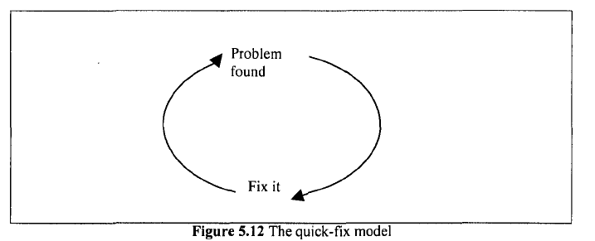
Maintenance Process Model: quick-fix
an ad hoc approach
an unreliable model
It is a 'firefighting' approach
waiting for the problem to occur and
trying to fix it as quickly as possible,

Slide 14
Why people use quick-fix model
pressure of deadlines and resources
If customers are demanding the correction of an error, for example, they may not be willing to wait for the organization to go through detailed and time consuming stages of risk analysis.
Often, a company will release a quick fix as a temporary measure.
The real solution will be implemented, along with other corrections and enhancements, as a major upgrade at a later date.

Slide 15
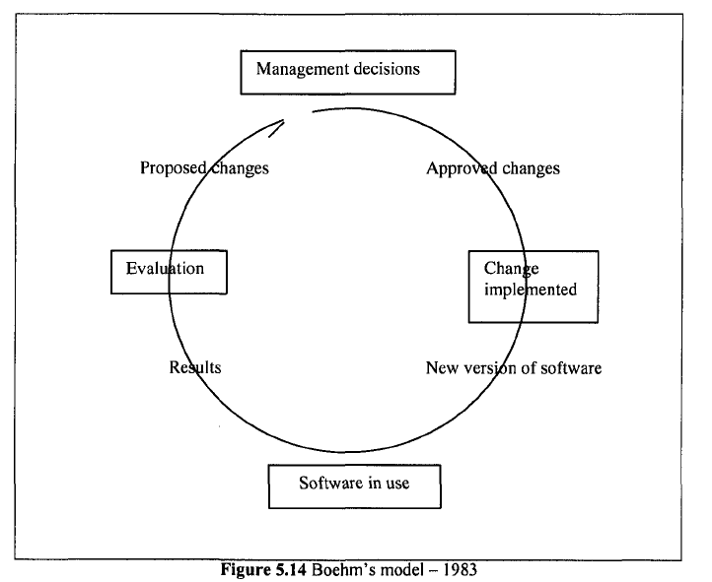
Maintenance Process Model: Boehm's Model
maintenance process based upon economic models and principles.
management decisions are made that drives the process.

Slide 16
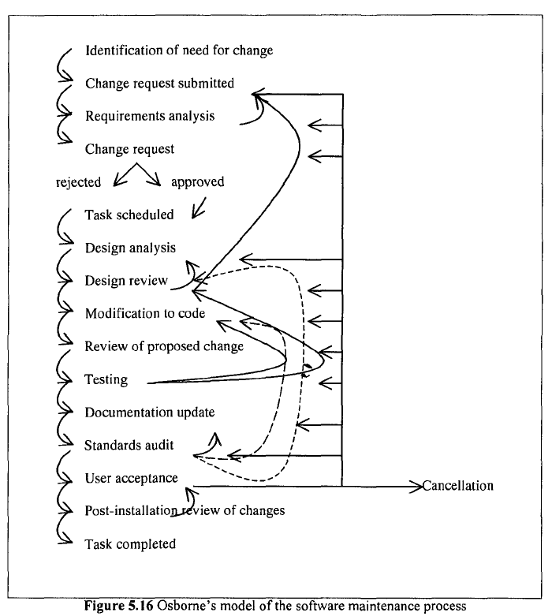
Maintenance Process Model: Osborne's Model
it deals directly with the reality of the maintenance environment.

